Slide 1
Progress Report
on
Data Analytics
Presented
by
Alisha Mehta 1510981015
Ashish Soni 1510981019
Under the supervision
of
Mr. Jaspreet Singh
Chitkara University

Slide 2
Introduction
Our project aims to achieve a score with R through a practical implementation on South African Heart Disease dataset.
The case study is based on a database containing 200 patients for whom it is desired to predict infarct exposure.
A data frame with 200 observations on the following 10 variables.
(1)sbp - systolic blood pressure
(2)tobacco - cumulative tobacco (kg)
(3)ldl - low density lipoprotein cholesterol
(4)adiposity - a numeric vector
(5)famhist - family history of heart disease(Absent/Present)
(6)Typea - type-A behavior
(7)obesity - a numeric vector
(8)alcohol - current alcohol consumption
(9)age - age at onset
(10)chd - response, coronary heart disease

Slide 3
Major Objectives to achieve
Exploration and Evaluation of Hadoop Distributed File System(HDFS)
Study and Implementation of R
Determining the probability of having a heart disease given the descriptors of the 200 patients by finding the risk of having heart disease based on different age groups.

Slide 4
Hardware/Software Requirements
Hardware:-
Intel® CORE i3,i5,i7
RAM- 8 GB or more
Hard Disk- 1 TB
Software:-
Operating System- Ubuntu
Java 6 or above
Hadoop-2.6.0 or above
R-Studio (version 3.3.2)

Slide 5


DIAGRAM
KNOWLEDGE
ANALYSE
PROBLEM STATEMENT
DATASET

Slide 6

HDFS ARCHITECTURE

Slide 7
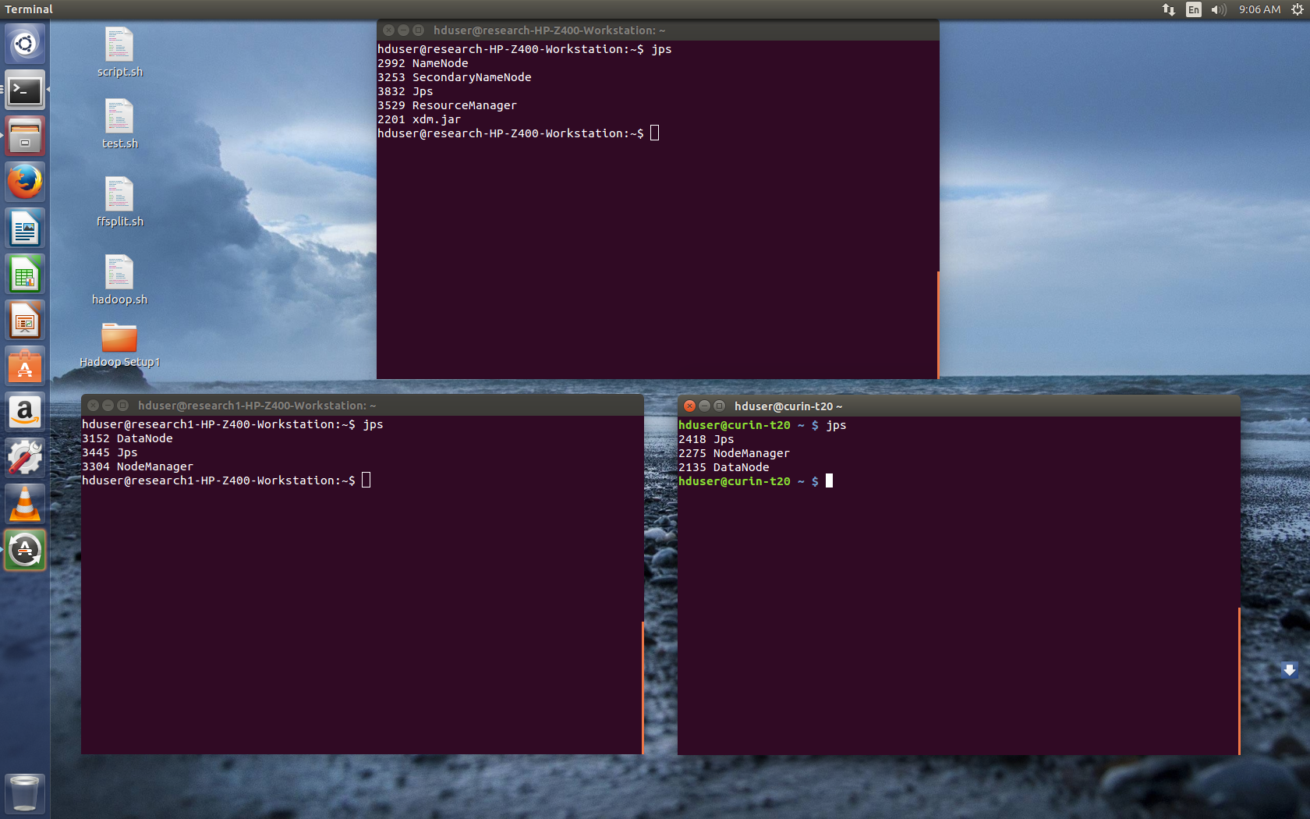
HADOOP INSTALLATION

Slide 8
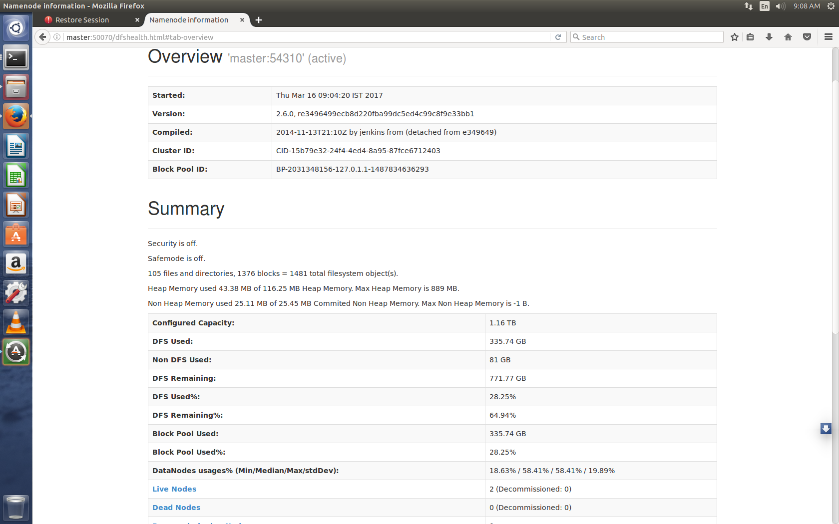
LIVE NAMENODE

Slide 9
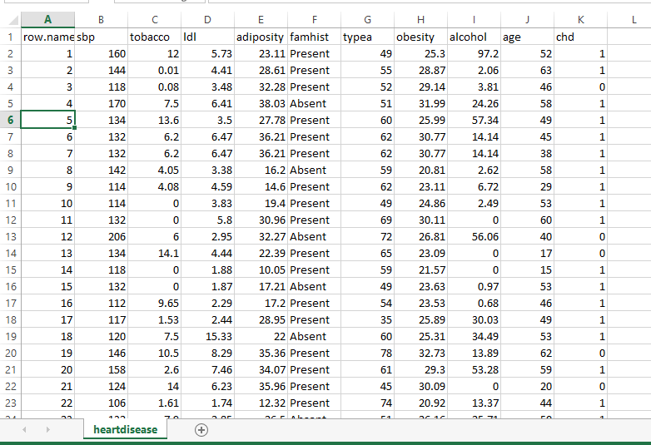
DATASET

Slide 10
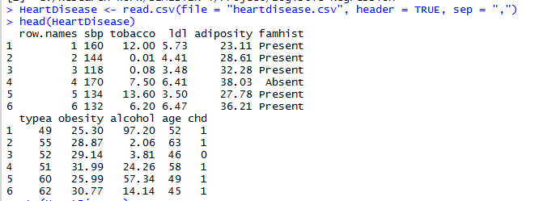
Snap Shots
Here we create a file named HeartDisease which reads the .csv file and head returns the first parts of a vector, matrix, table, database or function.

Slide 11
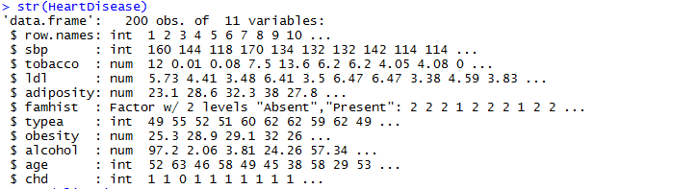
str(HeartDisease) compactly displays the internal structure of an object in R.

Slide 12
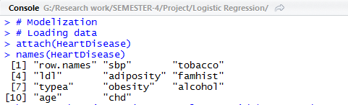
Modelization is a step by step process i.e. it is a succession of stages. attach(HeartDisease)- The database will be attached to R search path so as to access objects in the database by their names. names(HeartDisease)-function to get or set the names of an object.

Slide 13
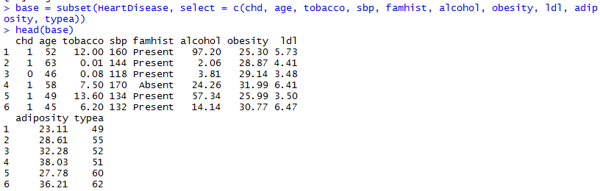
Base contains basic R functions like arithmetic etc. Subset returns subsets of vectors, matrices or data frames which meet conditions. Select is used to include all those attributes that satisfy the given profile.

Slide 14
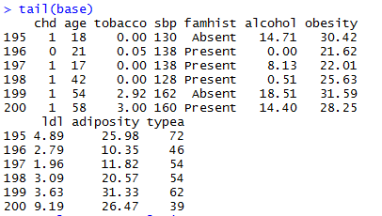
Tail returns the last parts of a vector, matrix, table, database or function.

Slide 15
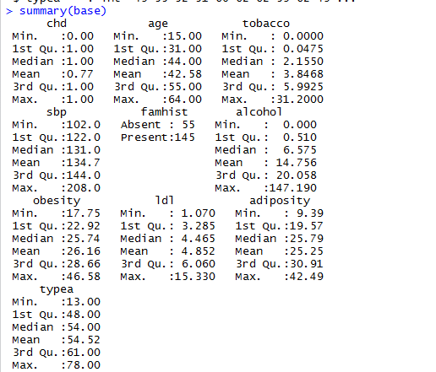
summary(base)- Generic function used to summarize the results of various models fitting functions.

Slide 16
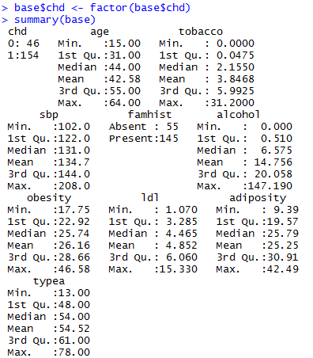
The target variant chd has been treated as a numerical variable: This is re-mediated by transforming it into factor type. Factor is stored as a vector of integer values with a corresponding set of char values to use when the factor is displayed.

Slide 17
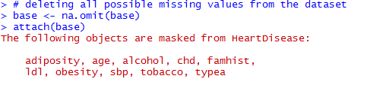
Omit is used to remove all the missing values

Slide 18
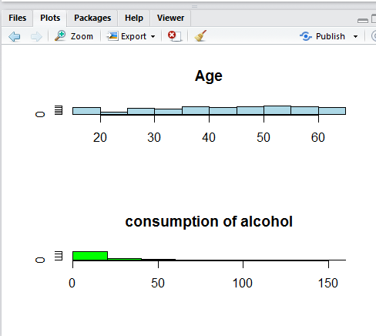
Par is used to combine plots and mfrow is used to create matrix of n rows n columns that are filled in by row. mfcol can be used to fill according to cols.

Slide 19
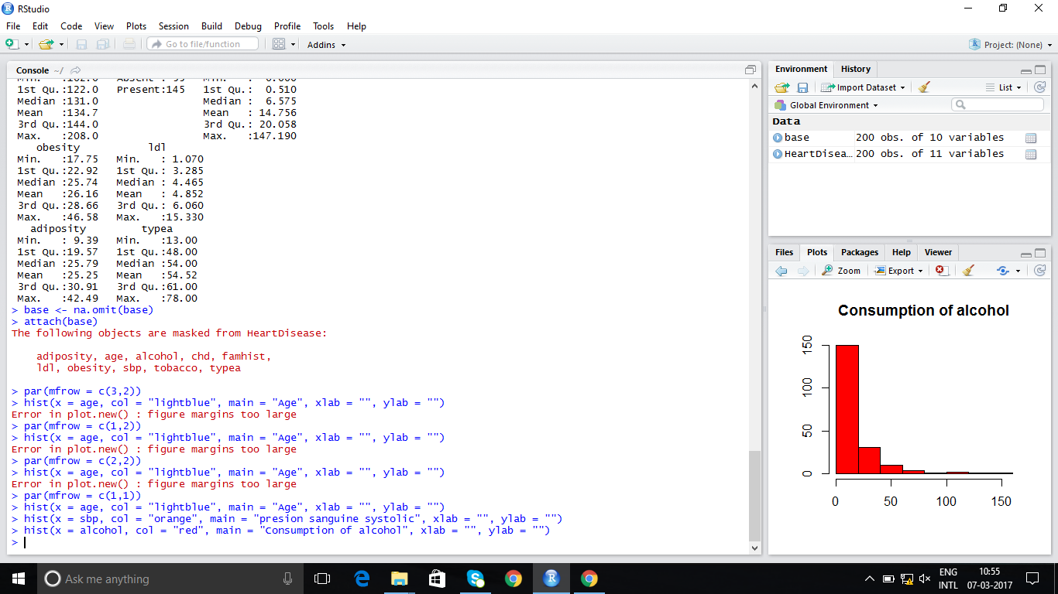

Slide 20
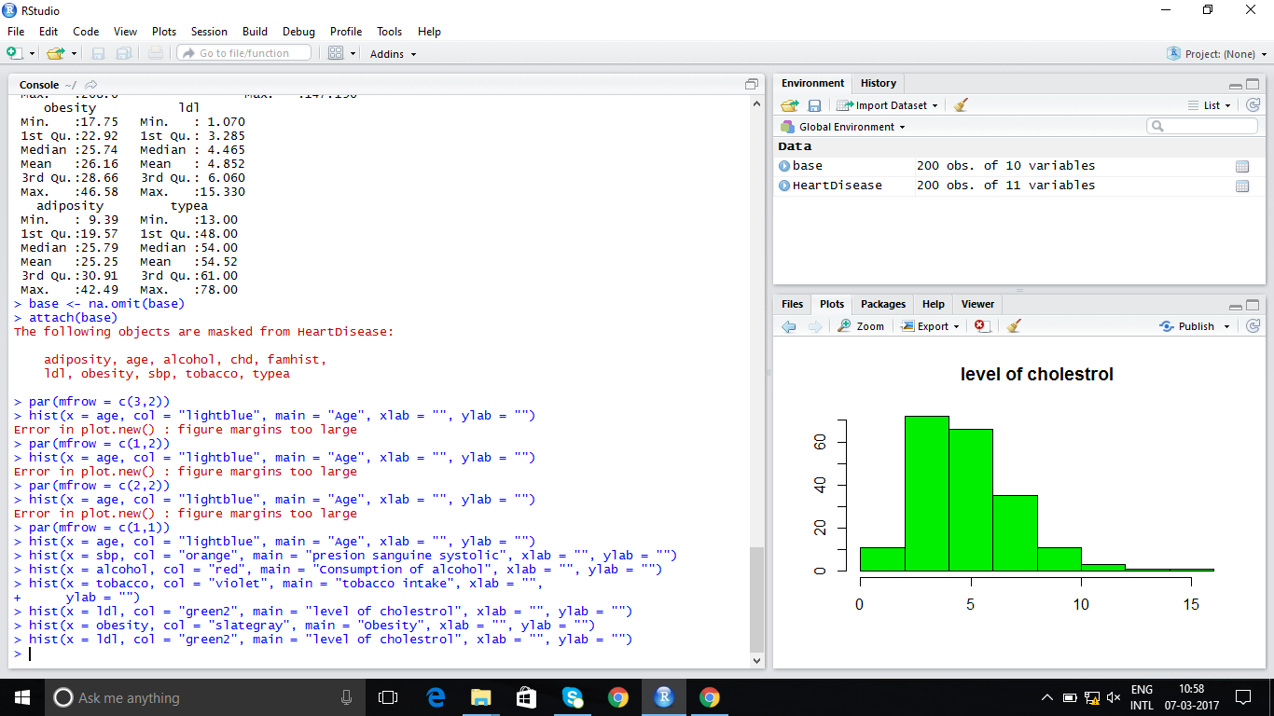

Slide 21
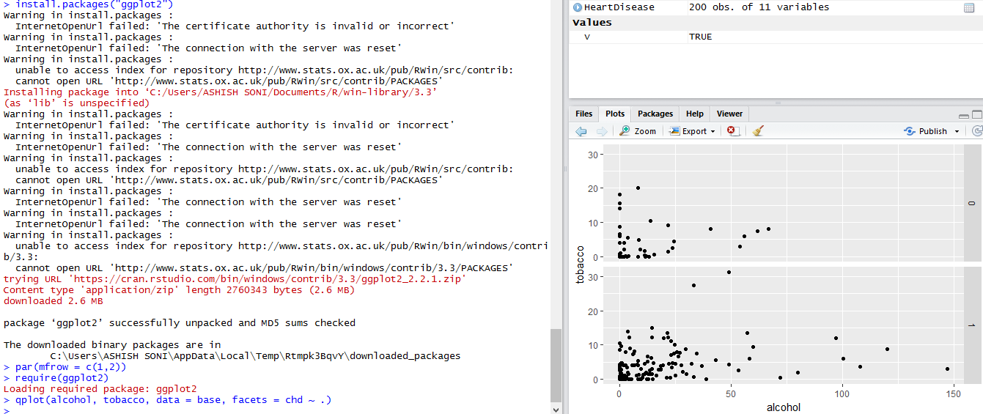

Slide 22


Slide 23
These initial analyzes indicate that:
It is not very useful to keep individuals under the age of 15 in the sample because the model being developed would not be calibrated to predict their likelihood of developing heart disease if age plays a role Therefore.
Some of the results described here descriptively need to be confirmed in a modeling phase.

Slide 24
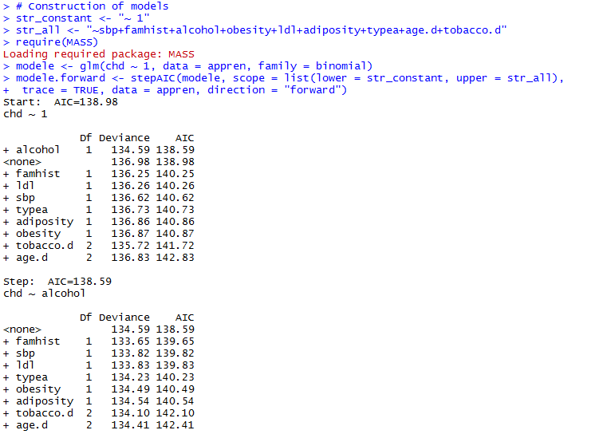

Slide 25
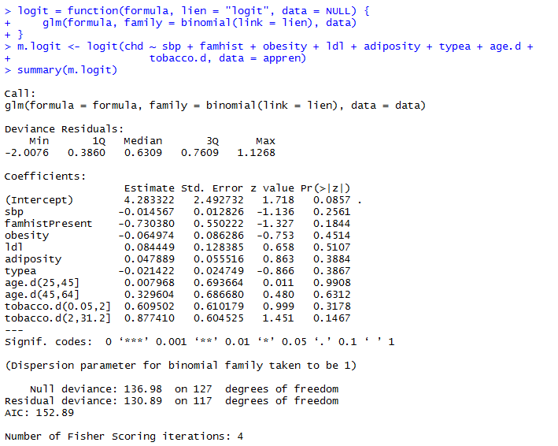
Modelization

Slide 26
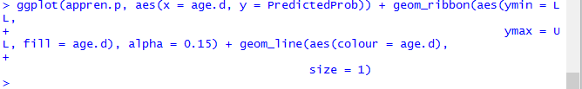

Slide 27
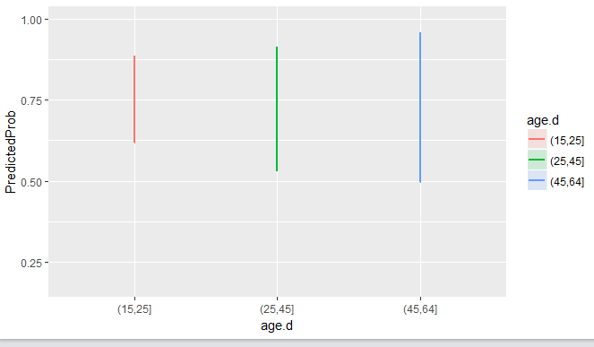

Slide 28
Conclusion
The use of Data Mining Techniques helped us determine that, analyzing patient information, based on data classification and prediction analysis, we identified that some variables can be used as proper predictors of heart disease.
The identified variables: sbp, ldl, chd, and famhist etc are the predictors for heart disease.
People between the ages of 45-64, based on the dataset, are more prone to a heart disease than people between the ages of 25-45 and 15-25.

Slide 29
Various histograms were obtained from the given dataset that indicated the relationship of various attributes.
Modelization and discretization was done on the basis of the available dataset and it was found that people under the age of 15 were not relevant for the analysis.
Test base was made too so as to check which model was better – forward AIC, backward AIC or both AIC.
ROC curve was made to validate the model.

Slide 30
REFERENCES
Source of the dataset:
Rousseauw, J., du Plessis, J., Benade, A., Jordaan, P., Kotze, J. and Ferreira, J. (1983). Coronary risk factor screening in three rural communities, South African Medical Journal 64: 430–436.
http://hadoop.apache.org/
Padhy, Rabi Prasad. "Big data processing with Hadoop-MapReduce in cloud systems." International Journal of Cloud Computing and Services Science 2.1 (2013): 16.

Slide 31
Thank you !!

